Slide 1
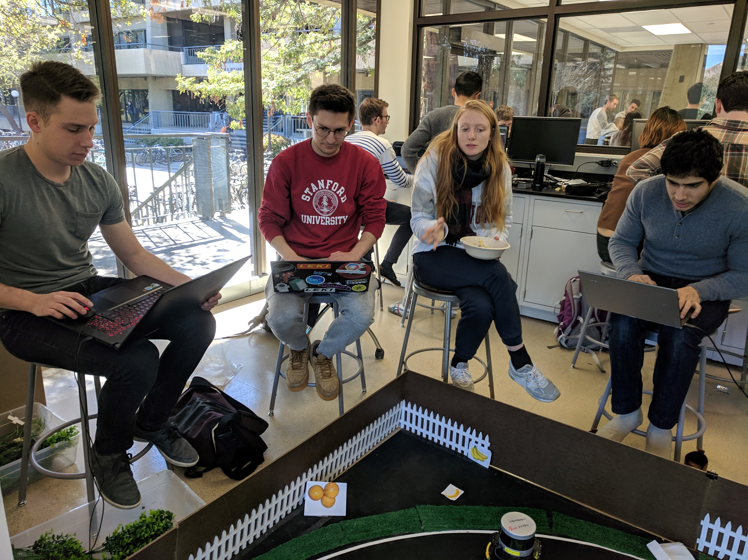
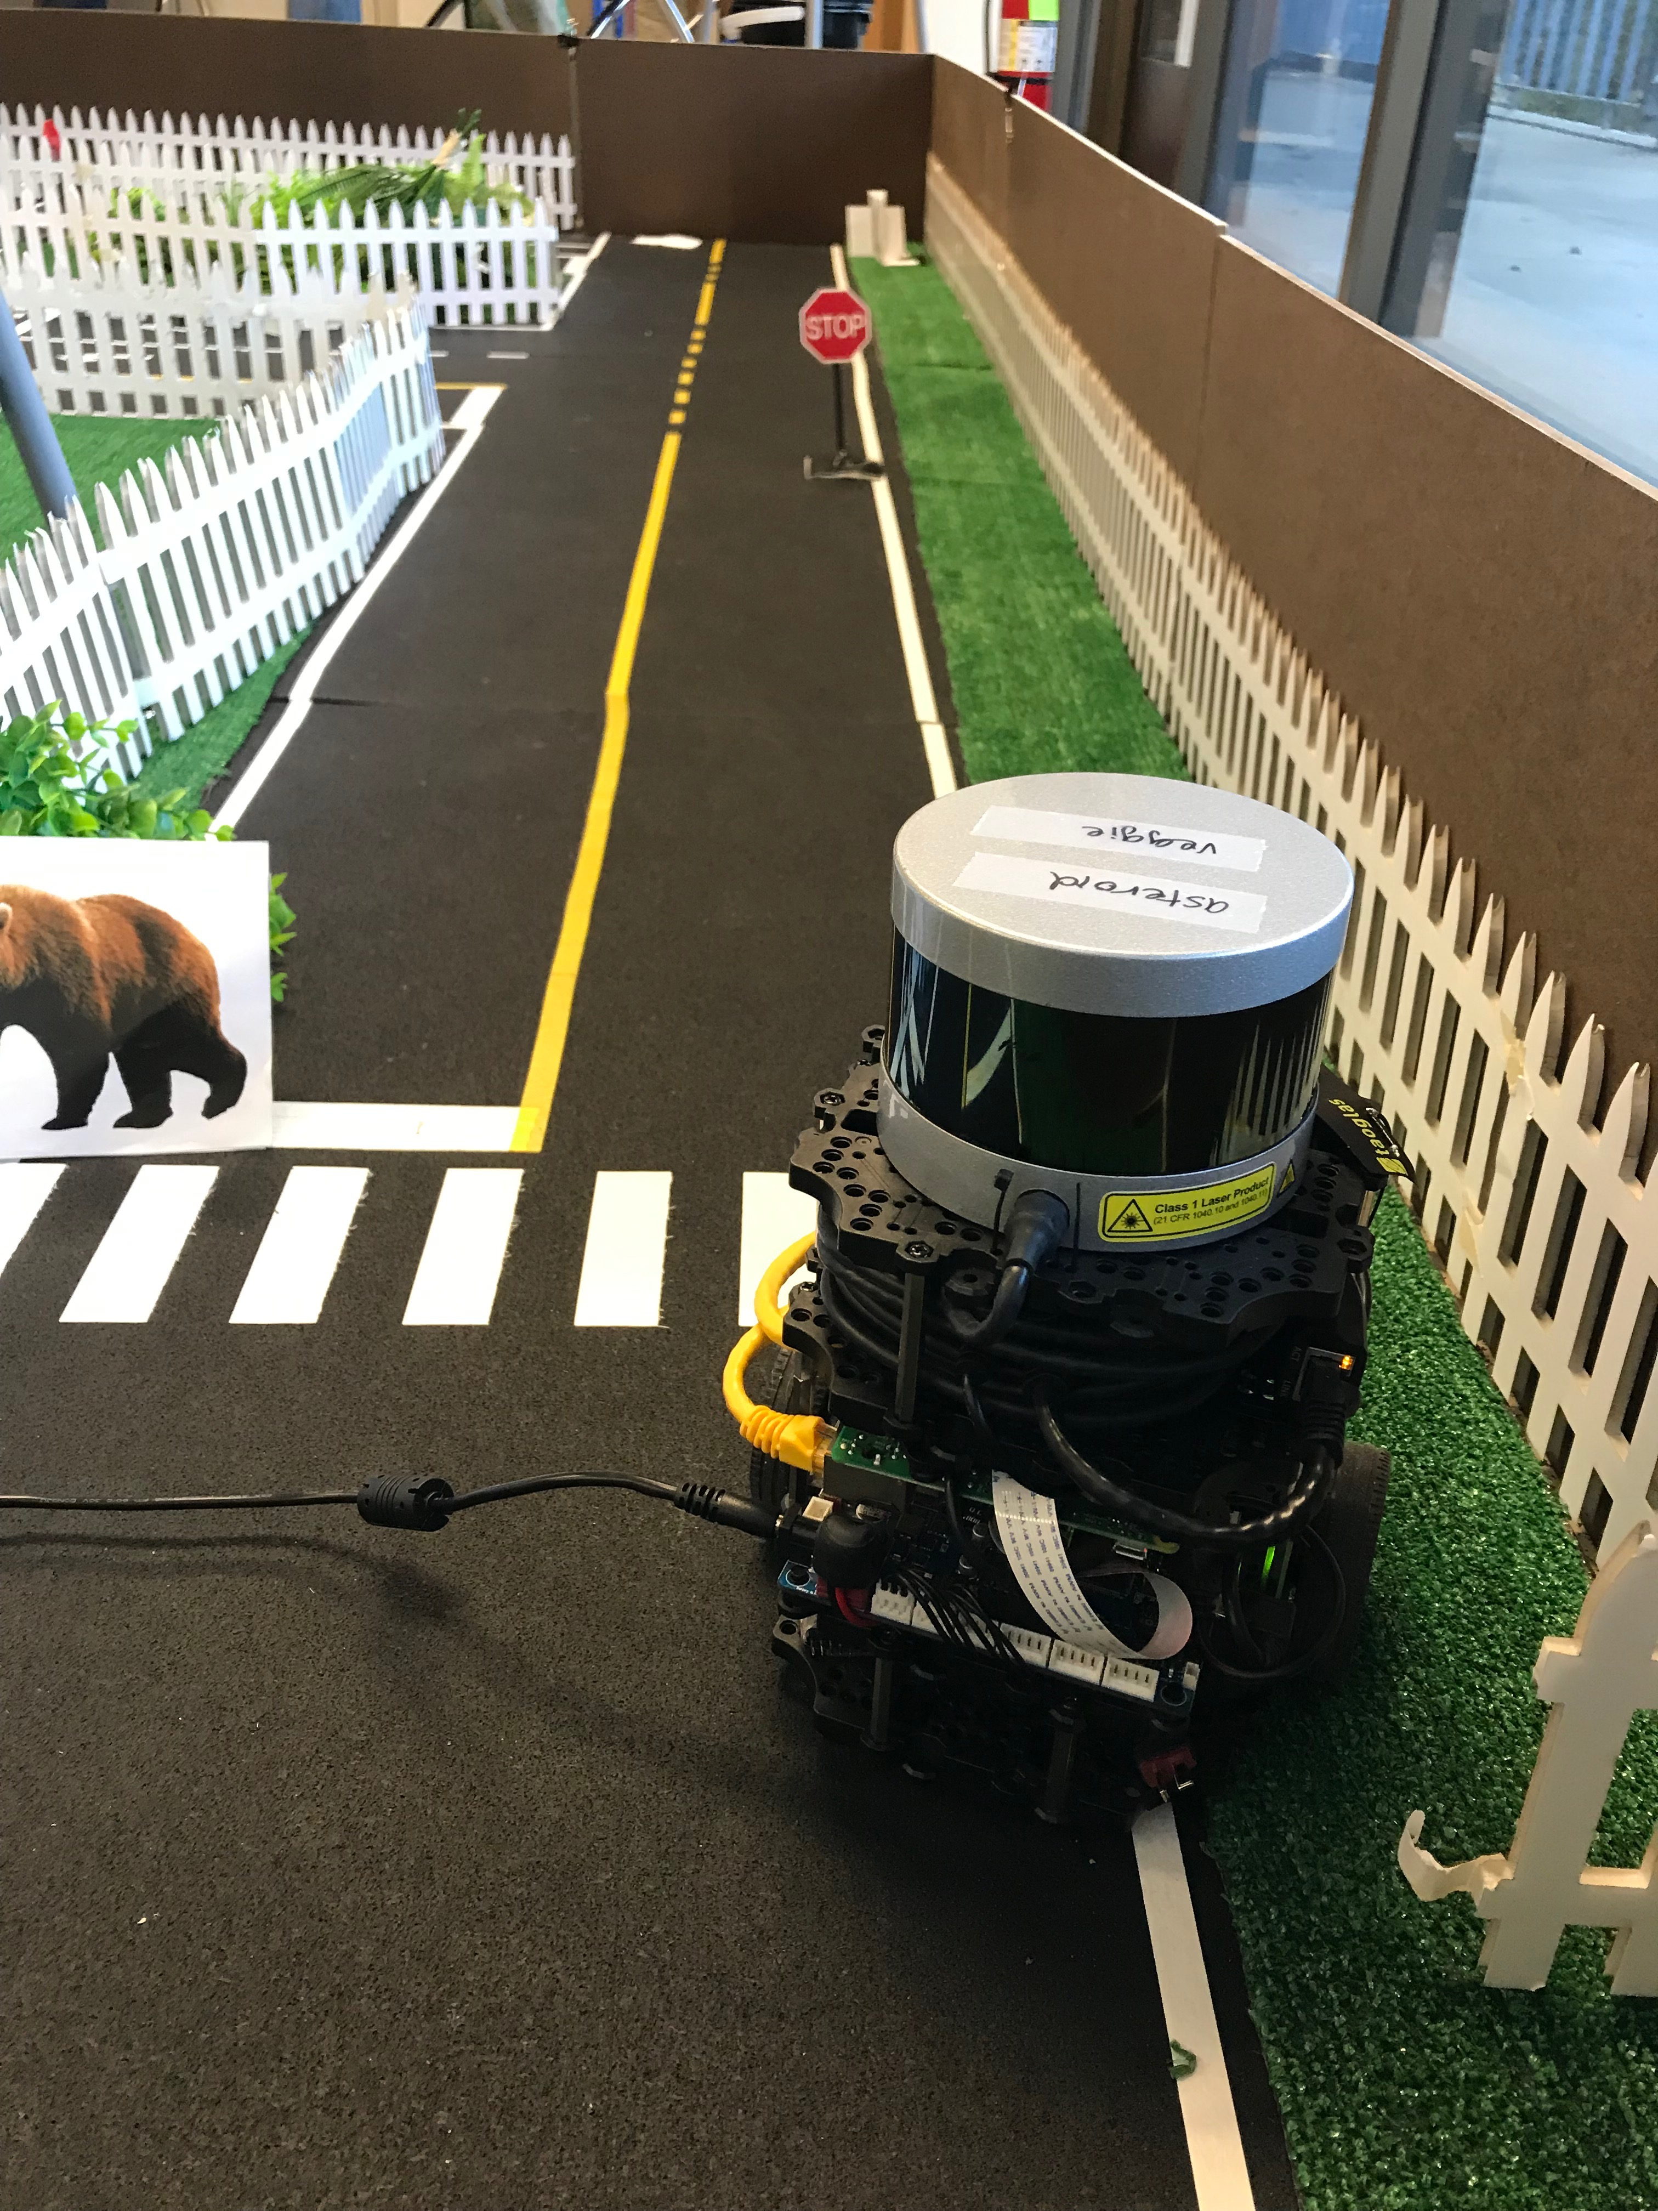
AA274 Team 3 Final Project Winter ‘19
Team 3 Members:
Adrian Costantino, Somrita Banerjee, Robert Dyro, Zoe Ghiron, Arec Jamgochian, Bernard Lange

Slide 2
Hardware/Software stack
Standard ASL Turtlebot equipped w/ Velodyne Lidar, NVIDIA Jetson embedded computer, Camera, Raspberry Pi Controller
Gmapping for SLAM
TensorFlow RESNET architecture for object detection
A* motion planning

Slide 3
Design Decisions
1) Initial exploration via tele-operation
Tried method of fixed waypoints for exploration, but variability in map sensing and odometry causing issues
2) Publishing dictionary of detected objects
RESNET architecture over MobileNets – seems to be more robust, but some occasional CUDA out-of-memory warnings
Detection requires vision at a close distance
3) Autonomous navigation to user-requested fruit via A*
4) Every delivery ends with home

Slide 4
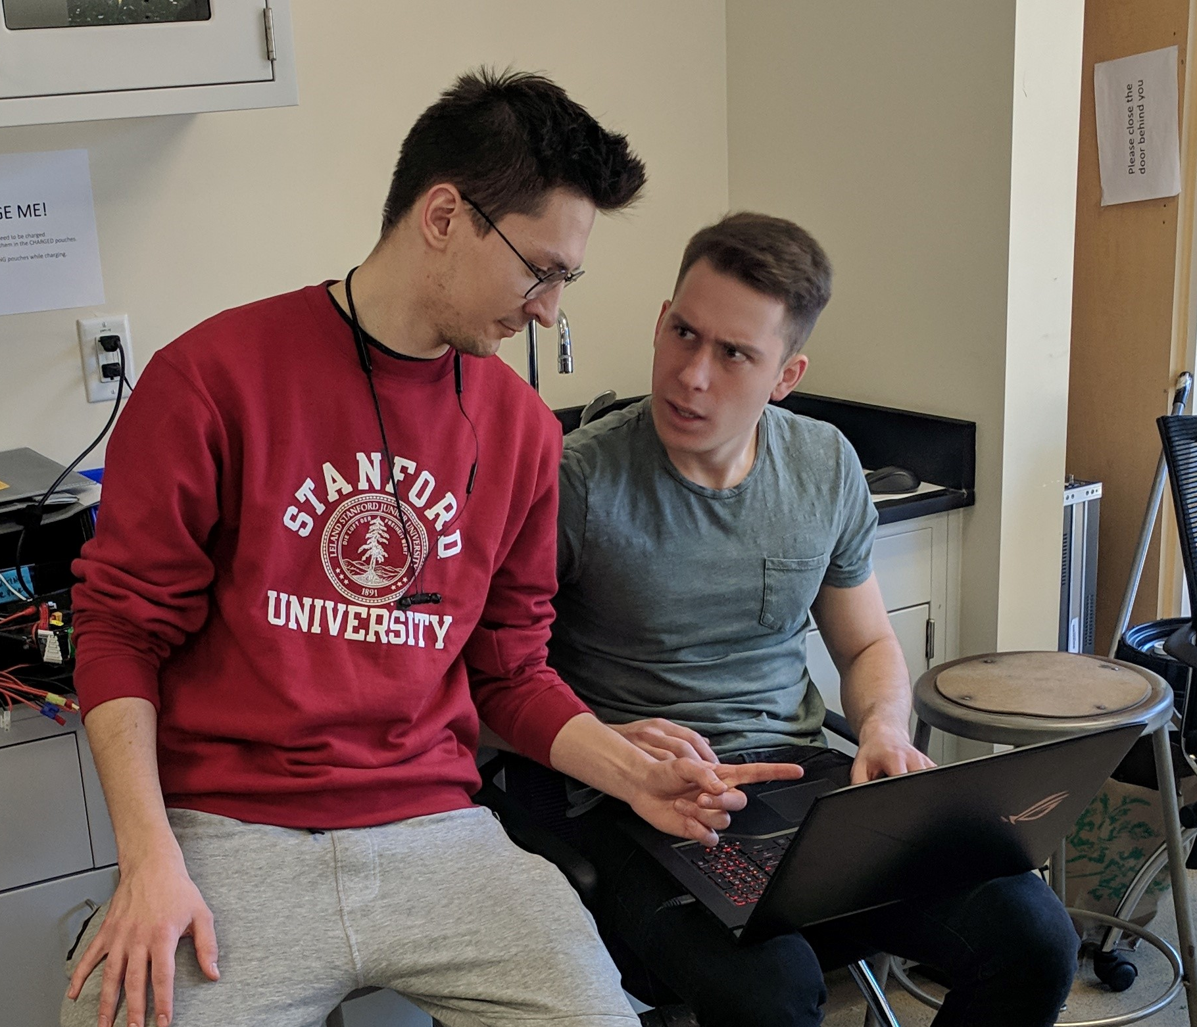
Why is our robot unique?
Markers to show current and target pose
Stop sign detection and stopping
Waypoints for initial environment exploration
Extra safety features (instant path termination utility)
Coming back home after fruit grabbing

Slide 5
Extra Robot Details
Initial path angle alignment gain was improved: allows for robust navigation between goals (no oscillations)
Adjusting the detector threshold (to improve the recall)

